Slide 1
Machine Learning Introduction
GPGN535
Ge Jin, Geophysics Department

Slide 2
Acknowledgement
Géron, A., 2019. Hands-On Machine Learning with Scikit-Learn, Keras, and TensorFlow: Concepts, Tools, and Techniques to Build Intelligent Systems. O'Reilly Media.
Nadima Dwihusna, Master Thesis

Slide 3

Machine learning and statistics
[Machine Learning is the] field of study that gives computers the ability to learn without being explicitly programmed.
--- Arthur Samuel, 1959

Slide 4
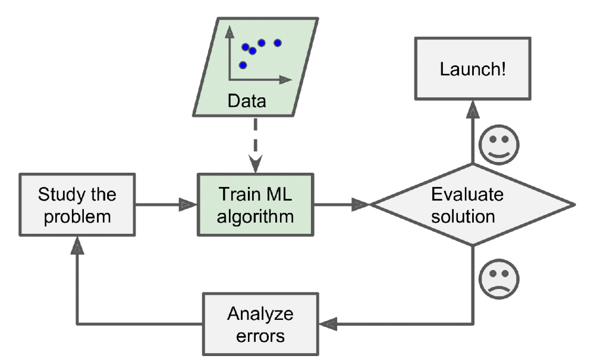
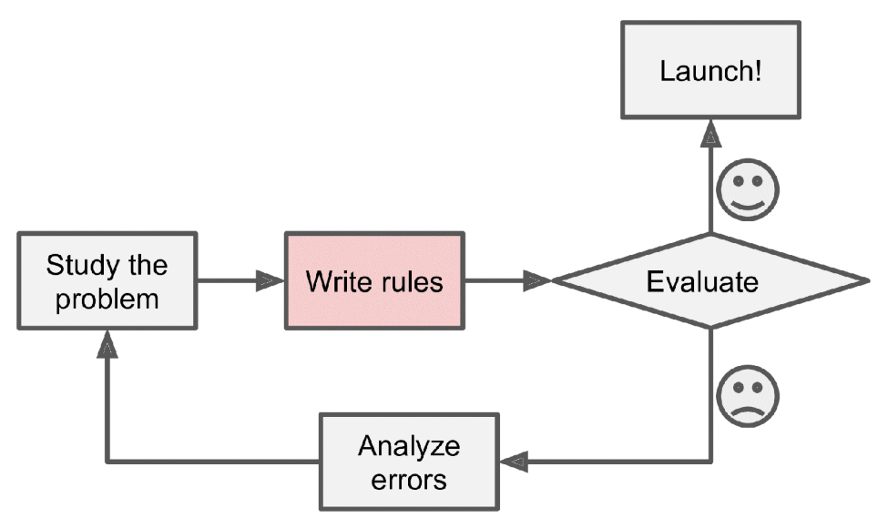
Traditional approach VS machine learning

Slide 5
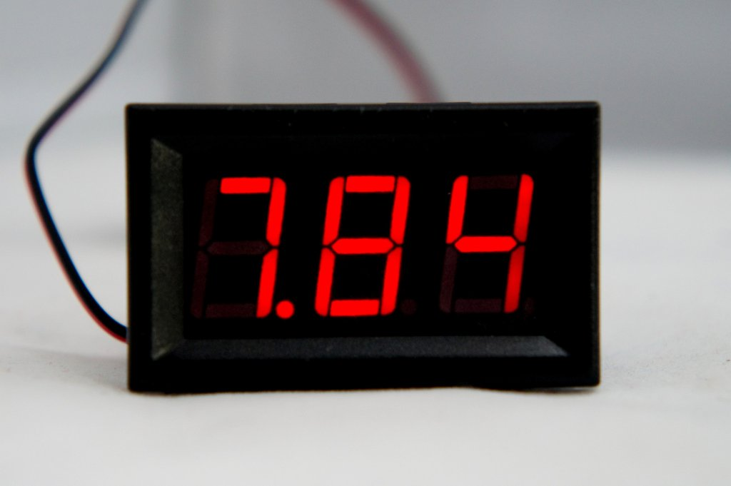
A simple problem
7.84

Slide 6
Traditional approach
1
6
2
4
7
0110011
5
3
4

Slide 7
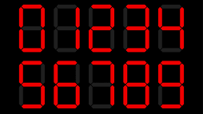
Machine learning approach
Training
Machine Learning Model
4

Slide 8
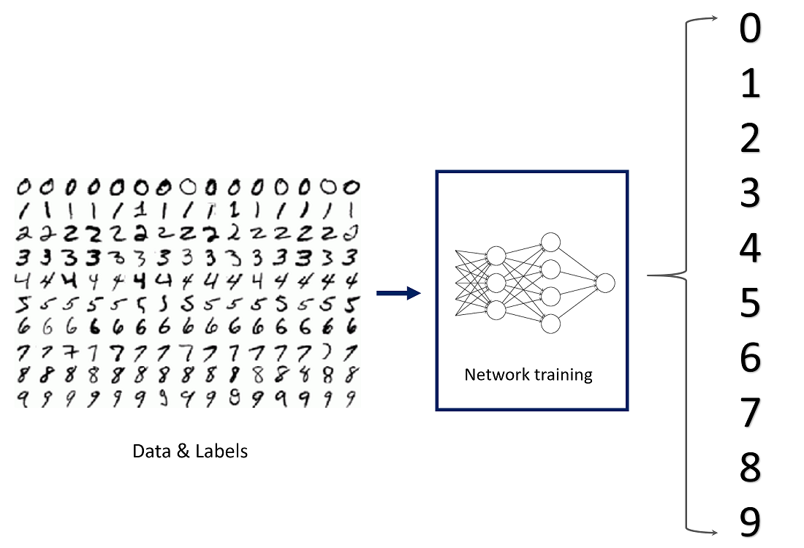
Handwriting recognition

Slide 9
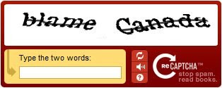
Collection the data: be smart

Slide 10
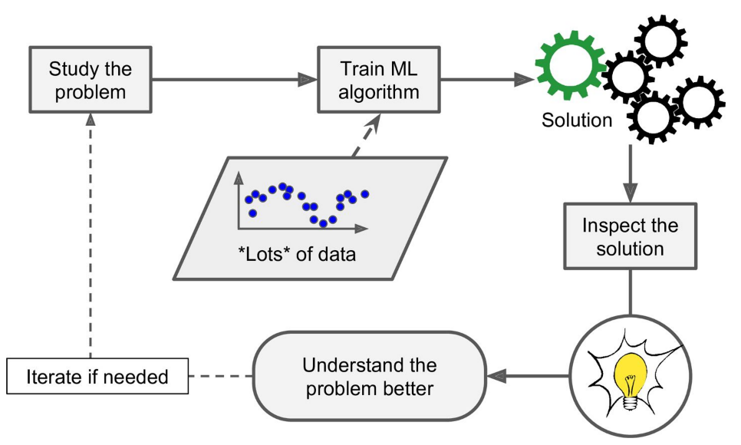
Data mining: gaining insights

Slide 11

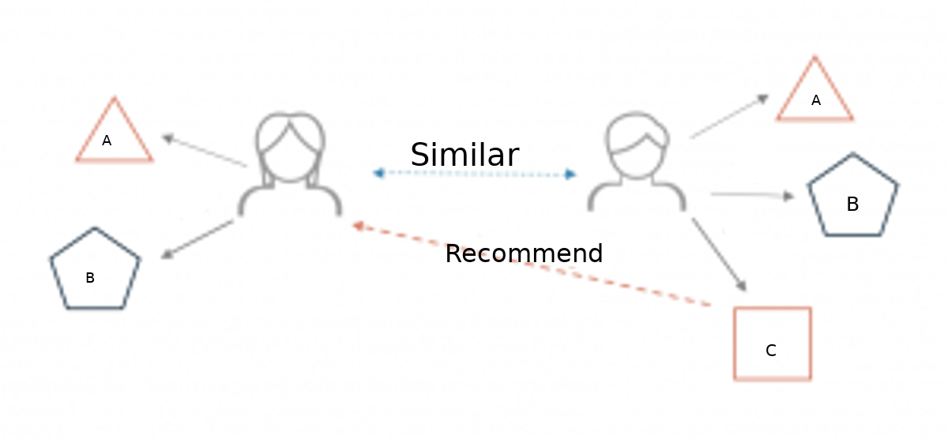
Data mining example: recommender system

Slide 12
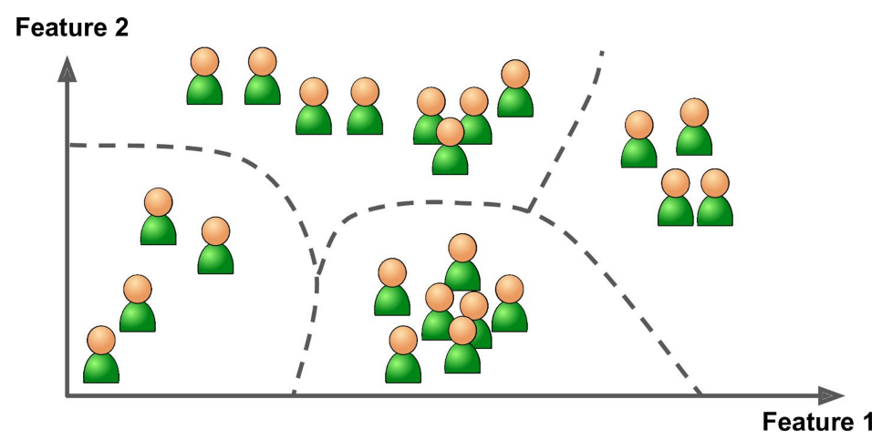
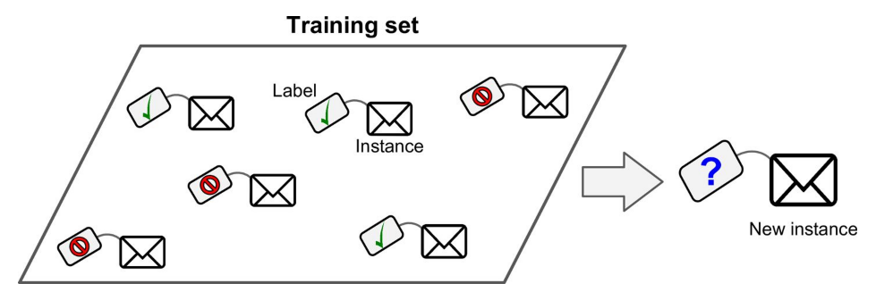
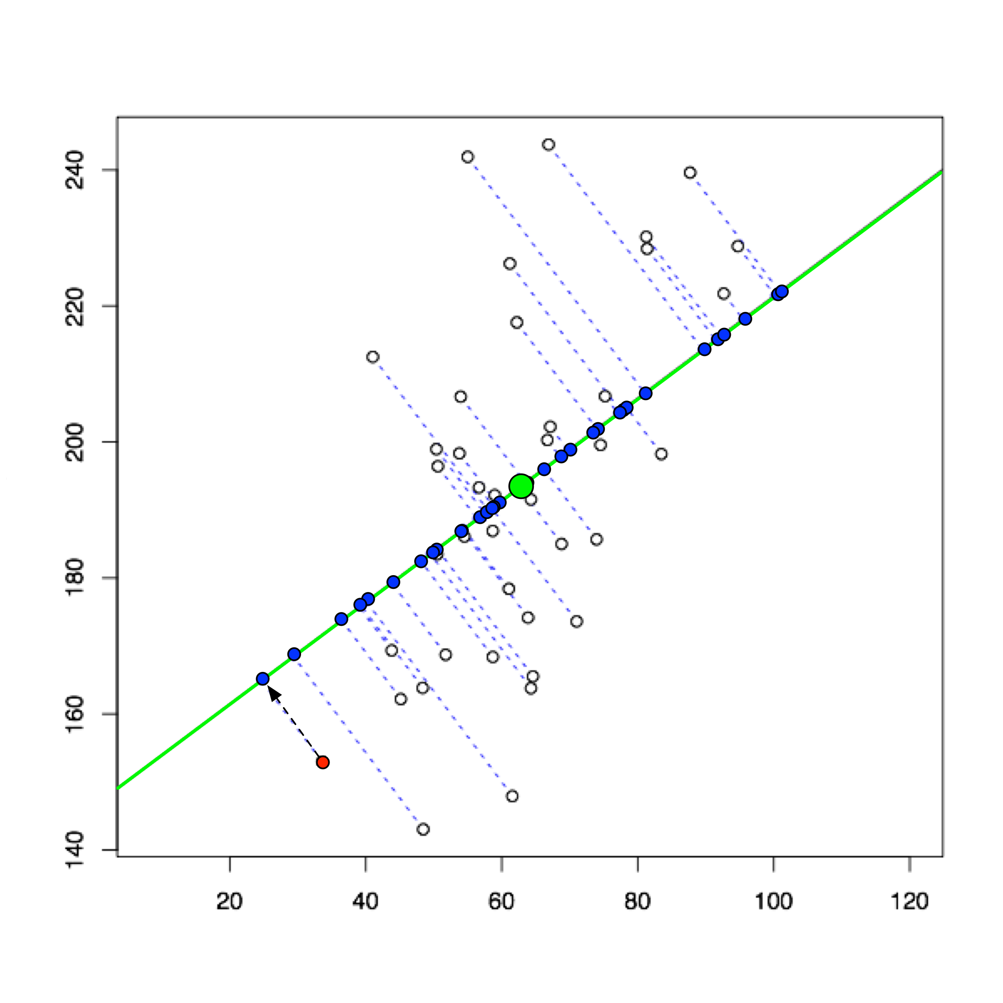
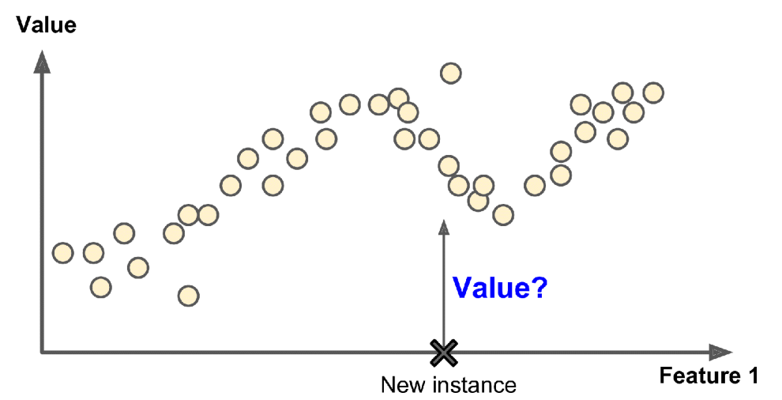
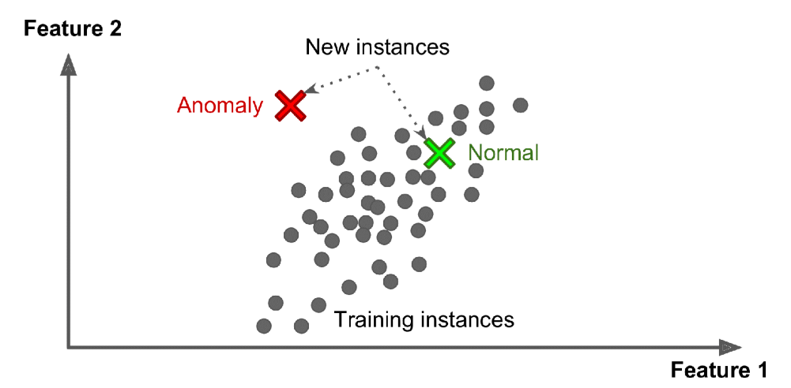
Unsupervised learning
Supervised learning
Clustering
Classification
PCA
Regression
Anomaly detection

Slide 13
Standard supervised machine-learning workflow
Dataset
Training
Validation
Testing
Train
Evaluation
Final evaluation
Machine learning models with different hypo-parameters
Best model

Slide 14
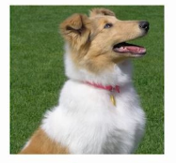
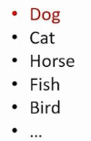
Classification
Binary classification
Multi-class classification

Slide 15
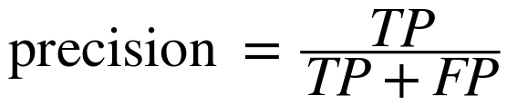

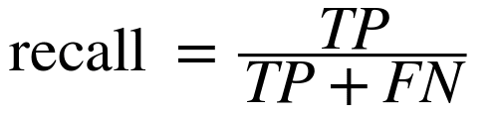
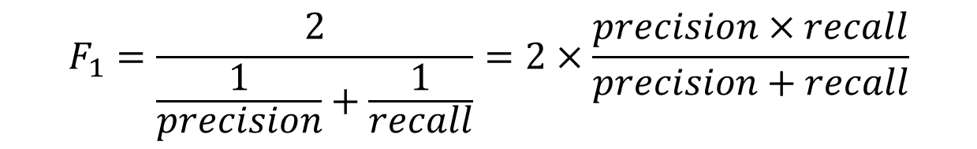
Result evaluation: binary classification
Confusion matrix
$$F_{1}=\frac{2}{\frac{1}{precision}+\frac{1}{recall}}=2×\frac{precision×recall}{precision+recall}$$

Slide 16
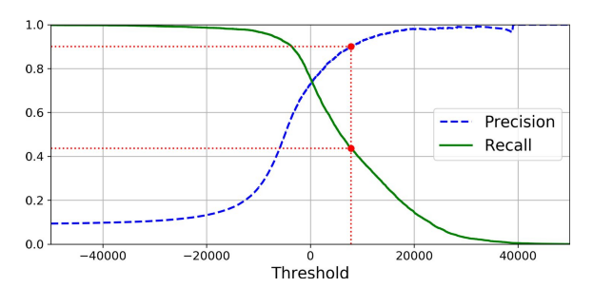
Trade-off between precision and recall

Slide 17
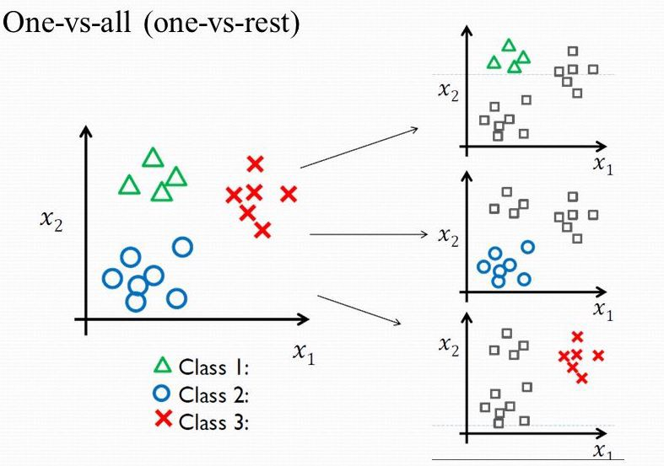
Multi-class classification

Slide 18
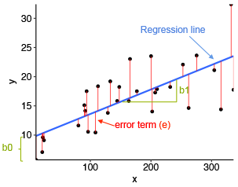
Regression

Slide 19
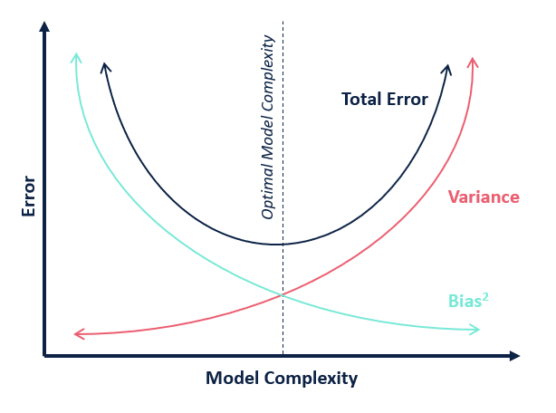
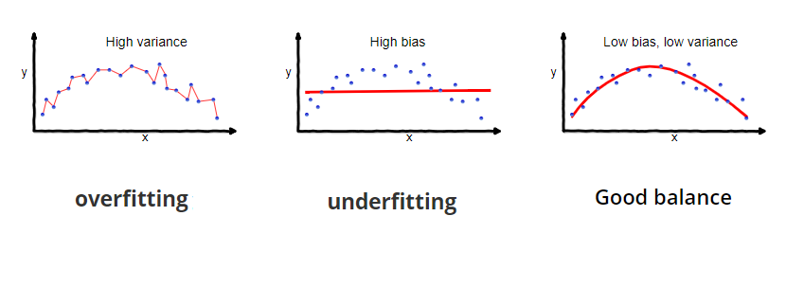
Model bias and variance

Slide 20
Python interface for supervised learning
from sklearn.xxx import modelxx
mod = modelxx(hypo-parameters)
mod.fit(X_train, y_train)
y_pred = mod.predict(X_val)
score = eval_xxx(y_pred,y_val)
Select model
Choose model parameters
Train model
Make model prediction
Evaluate model

Slide 21
Typical supervised learning input format
Features
Results
Model prediction
Data samples

Slide 22
Data pre-processing
Standardization
Imbalanced dataset

Slide 23
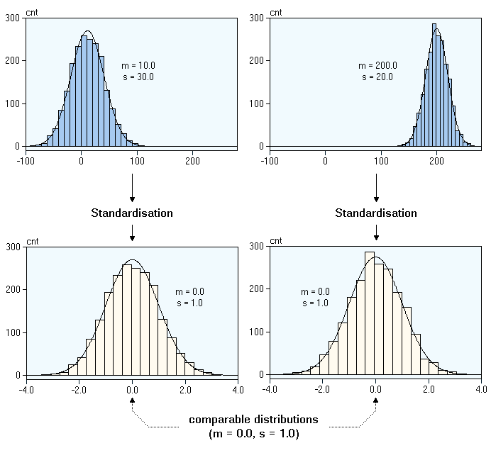
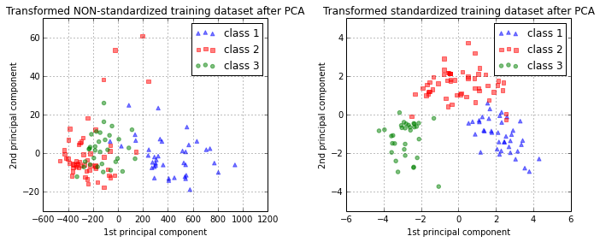
Standardization

Slide 24
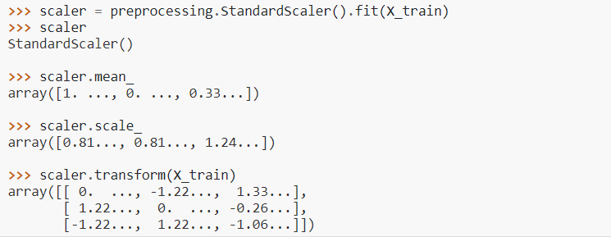
Standardization python interface

Slide 25

Imbalanced dataset
Resample technique
Oversample minority classes
Always split into test and train sets BEFORE trying oversampling techniques!
Python interface
sklearn.utils.resample

Slide 26
Supervised models
Linear regression
Logistic regression
Support Vector Machines
Decision Trees
Random Forest
Neural Networks
CNN

Slide 27
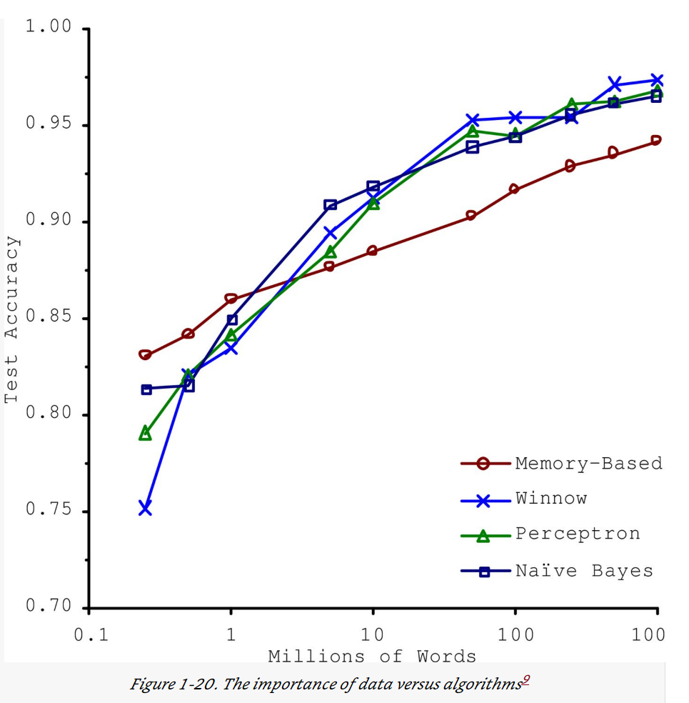
Before discussing different models….
Norvig et al. 2009

Slide 28
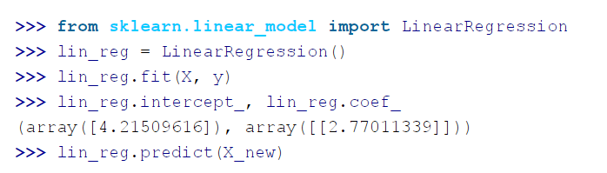
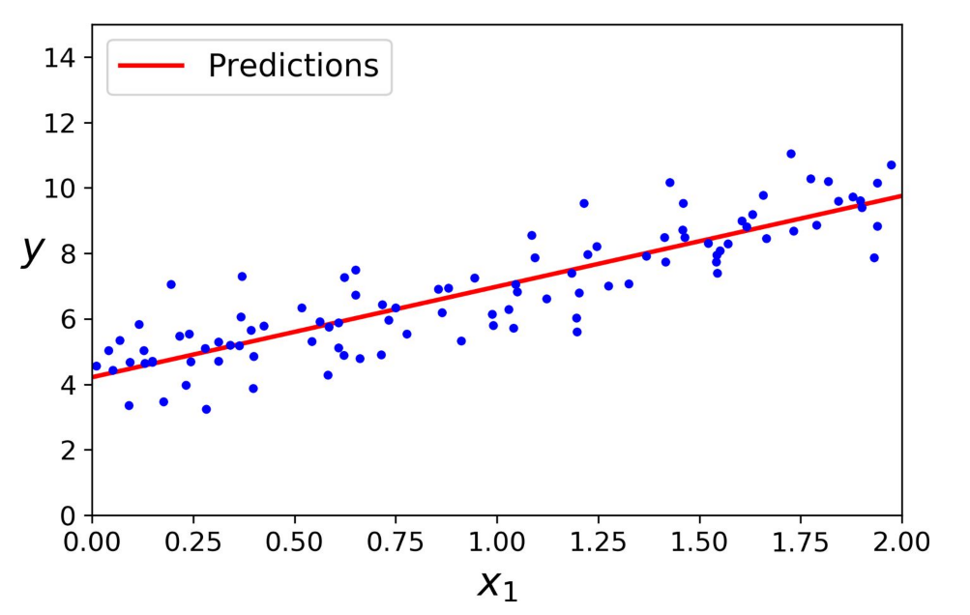
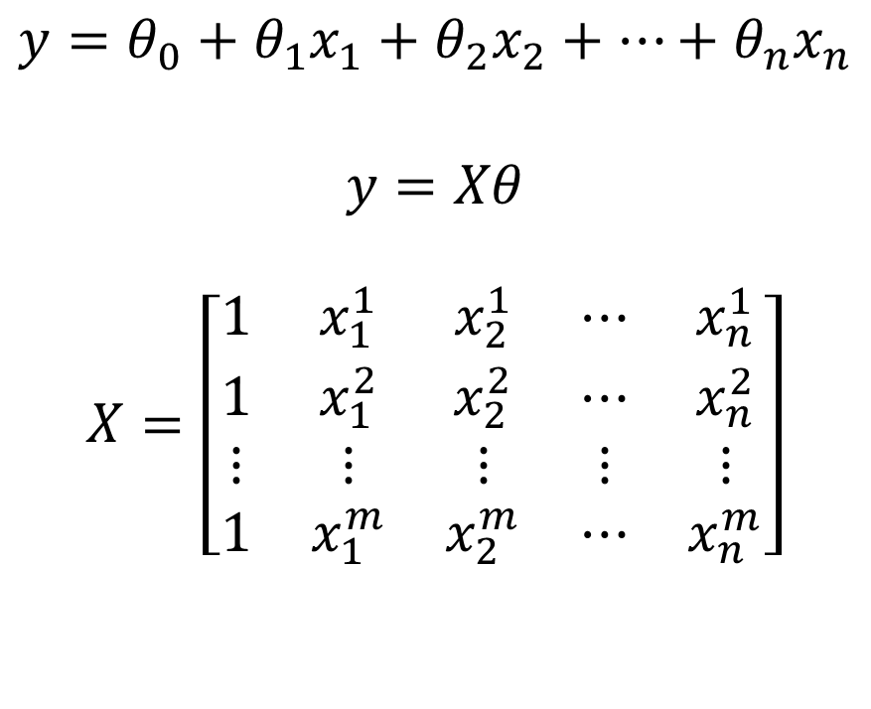
Linear regression
$$y=θ_{0}+θ_{1}x_{1}+θ_{2}x_{2}+…+θ_{n}x_{n}$$
$$y=Xθ$$
$$X=\left[\begin{matrix}1 & x_{1}^{1} & x_{2}^{1} & ⋯ & x_{n}^{1} \\ 1 & x_{1}^{2} & x_{2}^{2} & ⋯ & x_{n}^{2} \\ ⋮ & ⋮ & ⋮ & ⋮ & ⋮ \\ 1 & x_{1}^{m} & x_{2}^{m} & ⋯ & x_{n}^{m}\end{matrix}\right]$$

Slide 29
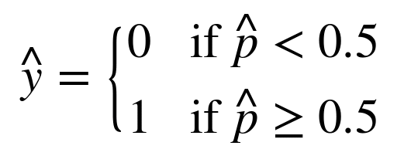
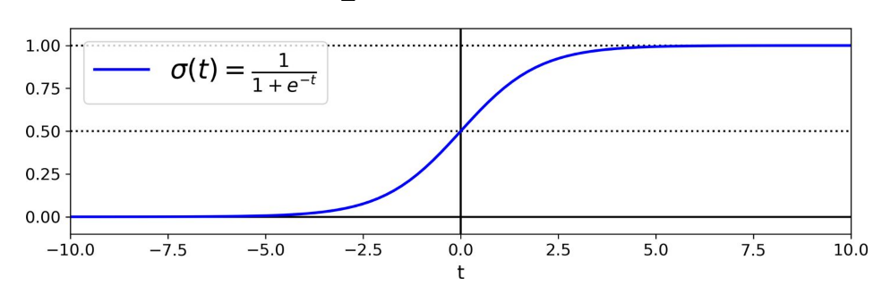

Logistic Regression
$$\hat{p}=σ\left(Xθ\right)$$
$$σ\left(t\right)=\frac{1}{1+\exp\left(−t\right)}$$

Slide 30
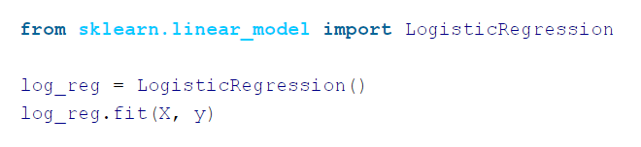
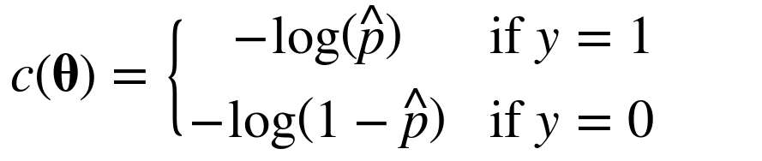
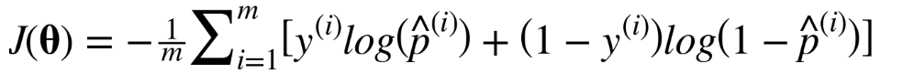
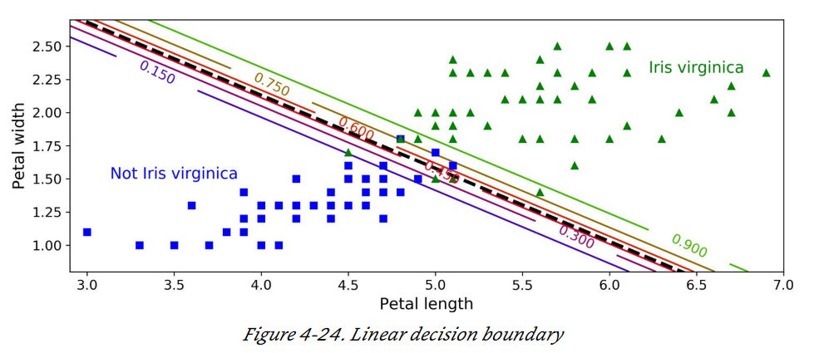
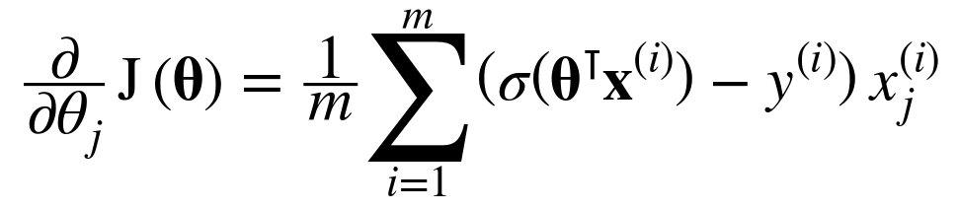
Logistic regression cost function
Individual sample:
All samples:
Gradient Decent:

Slide 31
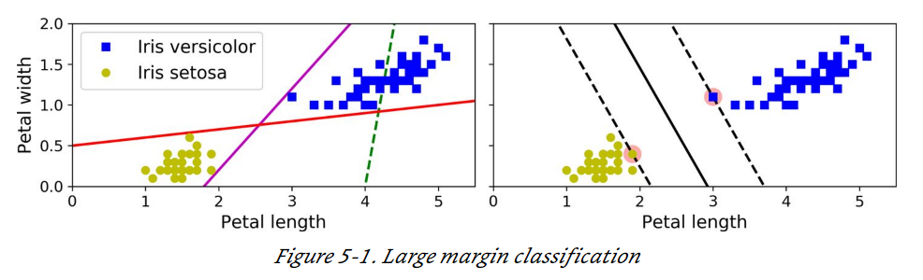
Support Vector Machine (SVM)

Slide 32
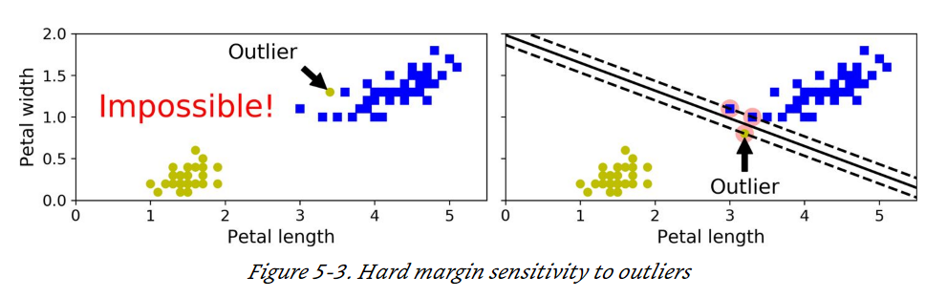
Soft margin classification

Slide 33
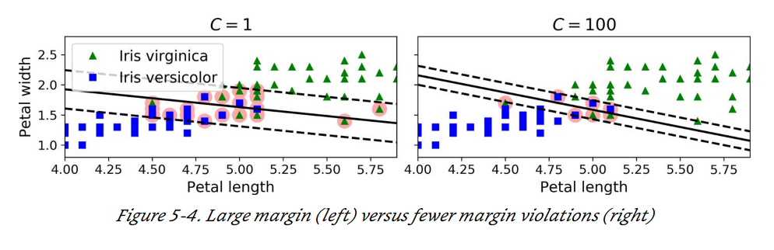
Soft margin tuning

Slide 34
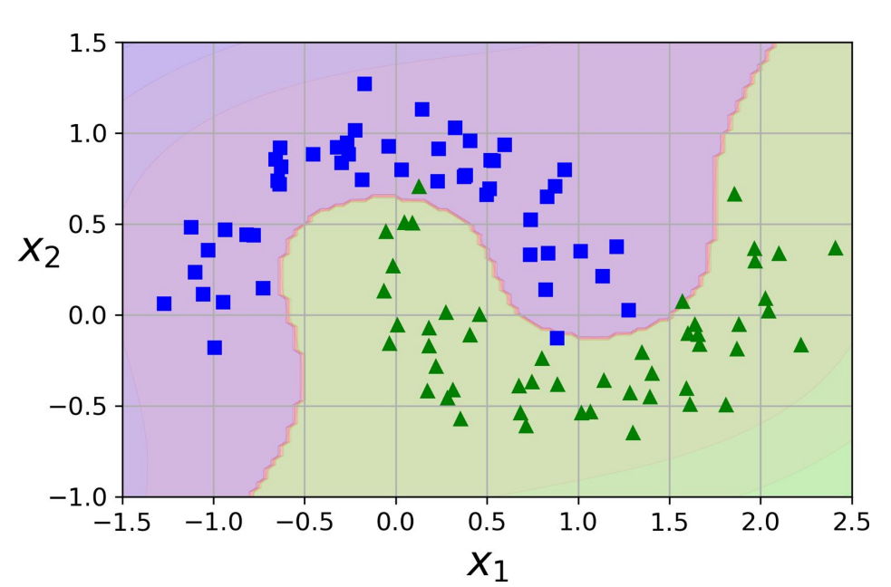
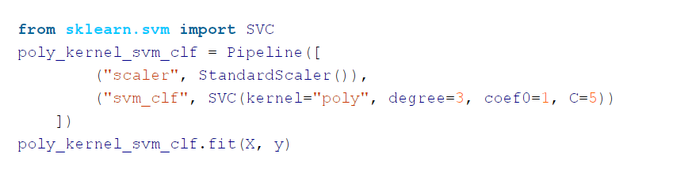
Nonlinear SVM Classification

Slide 35
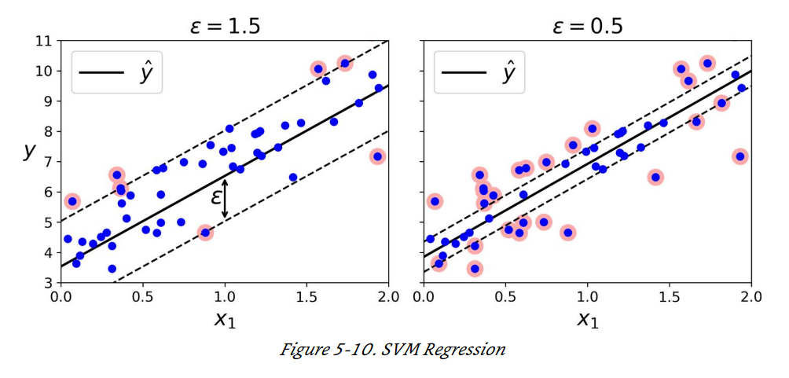
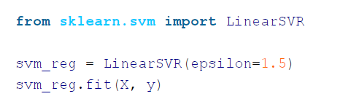
SVM Regression

Slide 36
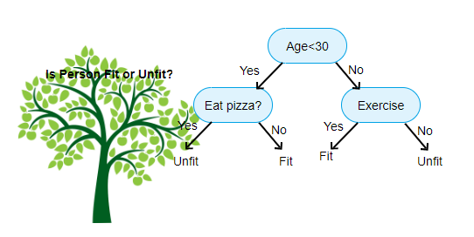
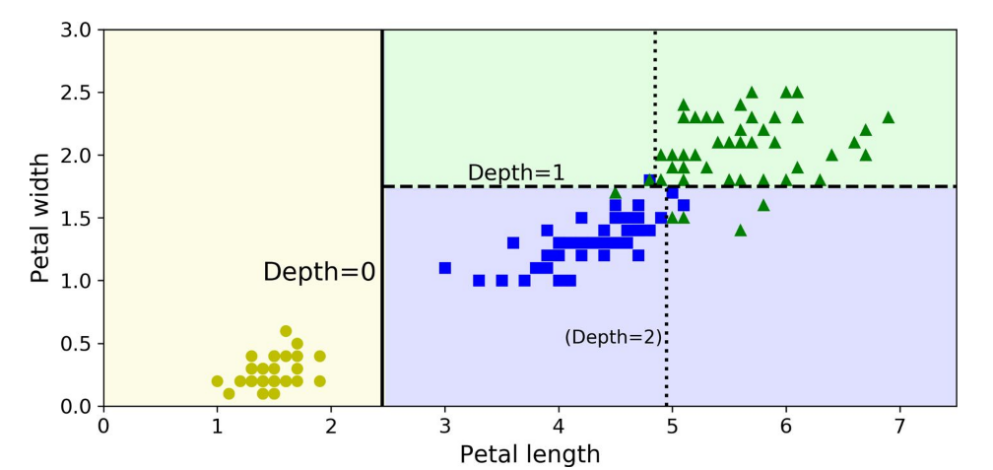
Decision trees

Slide 37
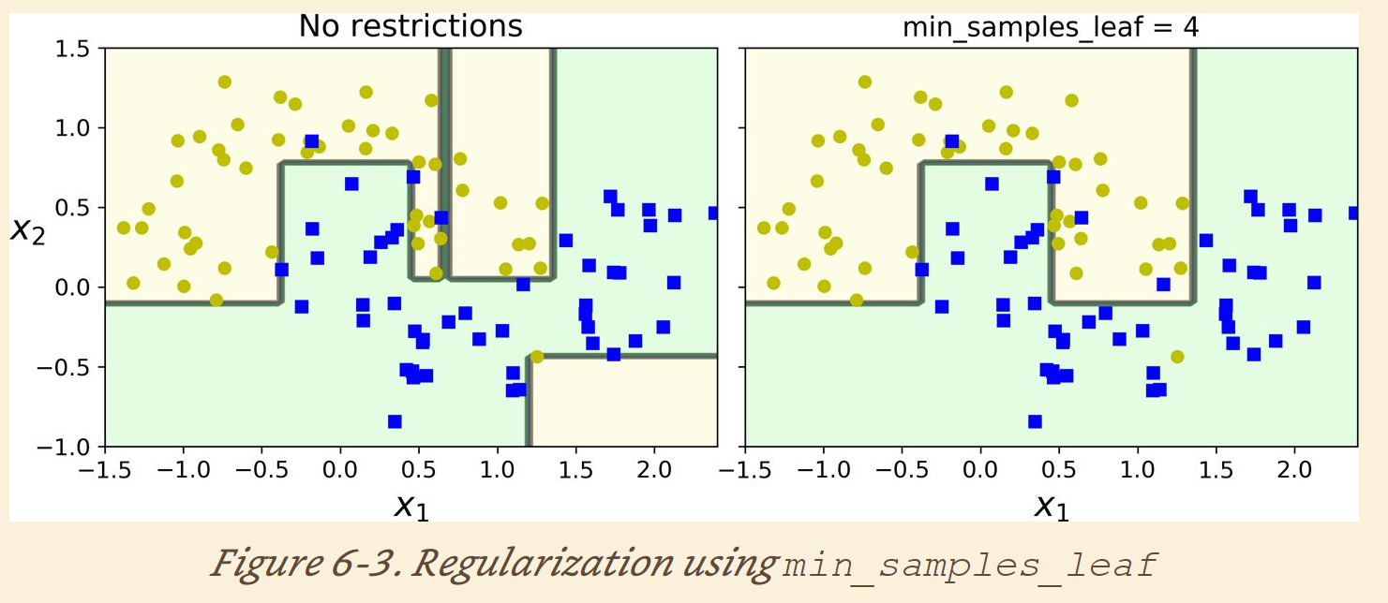
Decision tree regulations

Slide 38
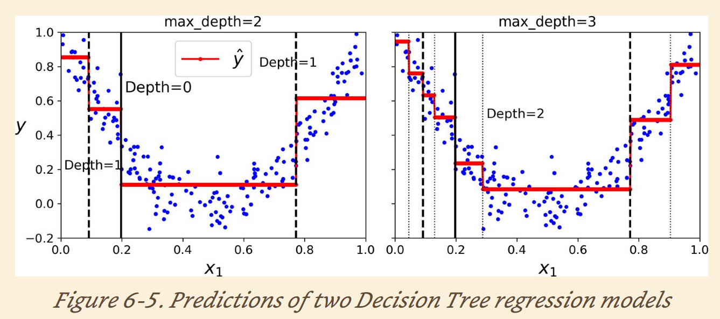
Decision tree regression

Slide 39
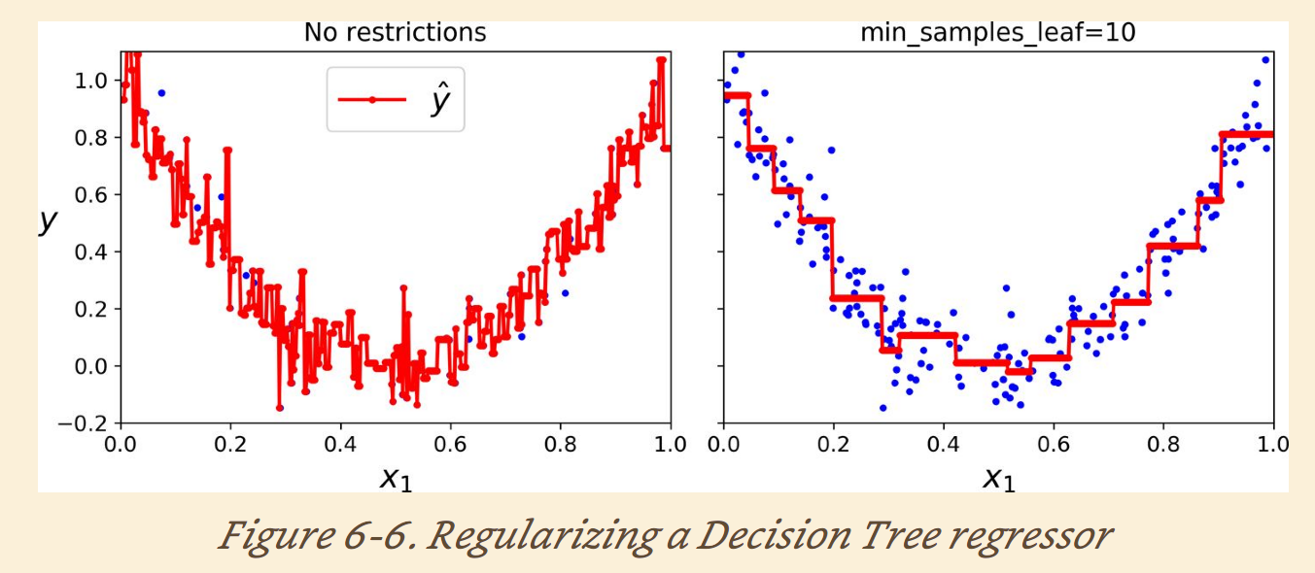
Decision tree regression regulations

Slide 40
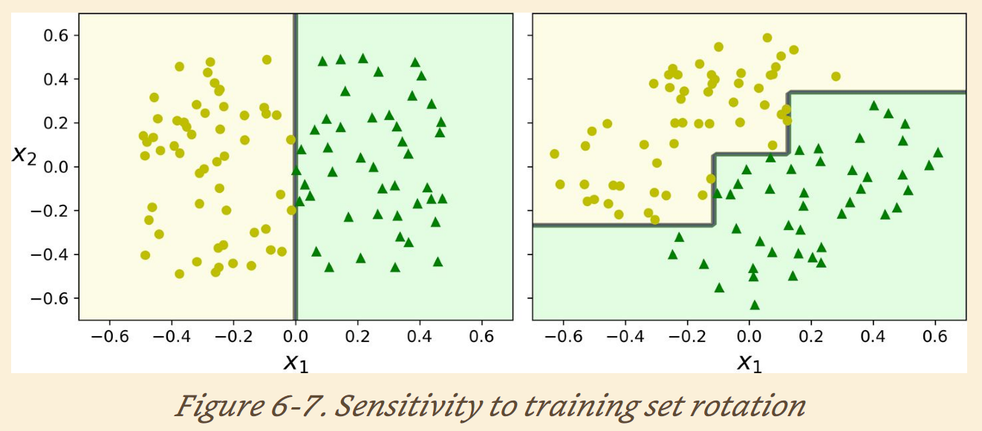
Decision tree sensitivity to data rotation

Slide 41


Random forest
Random subspace

Slide 42


Random forest decision boundary
Python interface

Slide 43

Feature importance of Random Forest
Measure of how the feature reduce impurity on average

Slide 44


AdaBoost

Slide 45


Gradient Boosting
Sequential models fit on residuals instead of changing weights

Slide 46

Stack

Slide 47


Stack

Slide 48

Multiplayer stacking ensemble

Slide 49


Neural Network

Slide 50


Neuron
$$y=f(x^{T}w)$$

Slide 51

Activation function

Slide 52

Multi-layer Neural Network

Slide 53




NN regression
$$y_{1}$$
$$y_{2}$$
$$y_{n}$$

Slide 54




NN multi-class classification
$$\begin{matrix}0 \\ \begin{matrix}0 \\ 0 \\ 1\end{matrix} \\ 0\end{matrix}$$

Slide 55


Dog or Bear

Slide 56

Dog or Candy

Slide 57




Python example of MLP

Slide 58



Python example of MLP

Slide 59

Deep learning and auto feature extraction

Slide 60

Convolutional filter

Slide 61

Convolutional filter

Slide 62

Pooling layers (subsampling)

Slide 63

CNN architectures

Slide 64
Python realization (Keras package)
model = keras.models.Sequential([
keras.layers.Conv2D( 64, 7, activation =" relu", padding =" same",
input_shape =[ 28, 28, 1]), keras.layers.MaxPooling2D( 2),
keras.layers.Conv2D( 128, 3, activation =" relu", padding =" same"),
keras.layers.Conv2D( 128, 3, activation =" relu", padding =" same"), keras.layers.MaxPooling2D( 2),
keras.layers.Conv2D( 256, 3, activation =" relu", padding =" same"),
keras.layers.Conv2D( 256, 3, activation =" relu", padding =" same"), keras.layers.MaxPooling2D( 2),
keras.layers.Flatten(),
keras.layers.Dense( 128, activation =" relu"),
keras.layers.Dropout( 0.5),
keras.layers.Dense( 64, activation =" relu"),
keras.layers.Dropout( 0.5),
keras.layers.Dense( 10, activation =" softmax") ])

Slide 65


Unsupervised learning
Dimensional reduction
Clustering

Slide 66
Dimensional reduction
Features (dimensions)
Features (dimensions)
PCA
Data samples
Data samples

Slide 67

C1
C3
C3
C2

Slide 68


Select number of Eigenvectors

Slide 69


Autoencoder

Slide 70

Autoencoder

Slide 71


Autoencoder example
Input
32
Output
28*28
784
28*28
784

Slide 72
Compression comparison between SVD and Autoencoder
SVD: 60% compression
Autoencoder: 96% compression

Slide 73

K-mean clustering

Slide 74

K-mean clustering fashion applications

Slide 75
Summary
Supervised learning for labelled data
Unsupervised learning for un-labelled data
There are many algorithms. Try them all!
Packages in python or other languages make machine learning implement very easy:
mod.fit -> mod.predict
Good data are more important than good algorithm.

Slide 76
Thank you for this semester
Please stay safe!

